Slide 1

Smart Energy-Monitoring Plug
Course Instructor:
Prof. Aishwarya Singh Gautam
Assistant Professor, B.Tech, SoCSE
School of Computer Science and Engineering
RV University, Bangalore
Team members
1RUA24CSE0072 - Aryav Agrawal
1RUA24CSE0066 - Arnav Deshmukh
1RUA24CSE0069 - Aryaman Misra
1RUA24CSE0077 - Ayush Bhanja

Slide 2
Outlines
Abstract
Introduction and Problem statement
Architecture
System Analysis and Requirements
Circuit Diagram
Future work
References

Slide 3
Abstract
This project introduces a Smart Energy-Monitoring Plug that tracks electricity usage and allows remote control of appliances. Using an ESP32 with a current sensor and relay, the system measures power consumption and transmits data via Wi-Fi to a mobile dashboard. Users monitor usage, schedule devices, and receive alerts, promoting energy savings and smart living.

Slide 4
Introduction
With the rapid growth of electrical appliance usage in homes, hostels, and offices, energy wastage has become a common issue. Many users forget to turn off fans, lights, or other devices, leading to unnecessary power consumption and higher electricity bills. Traditional plug points only provide a simple ON/OFF connection and lack the ability to monitor usage or offer remote control. This creates a need for smarter solutions that combine convenience, monitoring, and automation in a single device.

Slide 5
Problem Statement
Appliances left running unnecessarily cause high bills and energy waste. Traditional plugs lack monitoring and control.
Problem: No affordable device in India offers real-time monitoring + remote control.
Solution: An IoT-enabled smart plug that is portable, safe, and efficient.

Slide 6
Architecture
Input: AC → Plug → Relay → Appliance
Sensing: Current sensor measures usage
Processing: ESP32 reads and processes data
Communication: Wi-Fi sends data to app/cloud
Output: Appliance ON/OFF, alerts, scheduling

Slide 7
System Analysis and Requirements
Hardware: ESP32, ACS712/PZEM-004T sensor, relay, plug/socket, OLED (optional), casing.
Software: Arduino IDE, Blynk/Thingspeak.

Slide 8
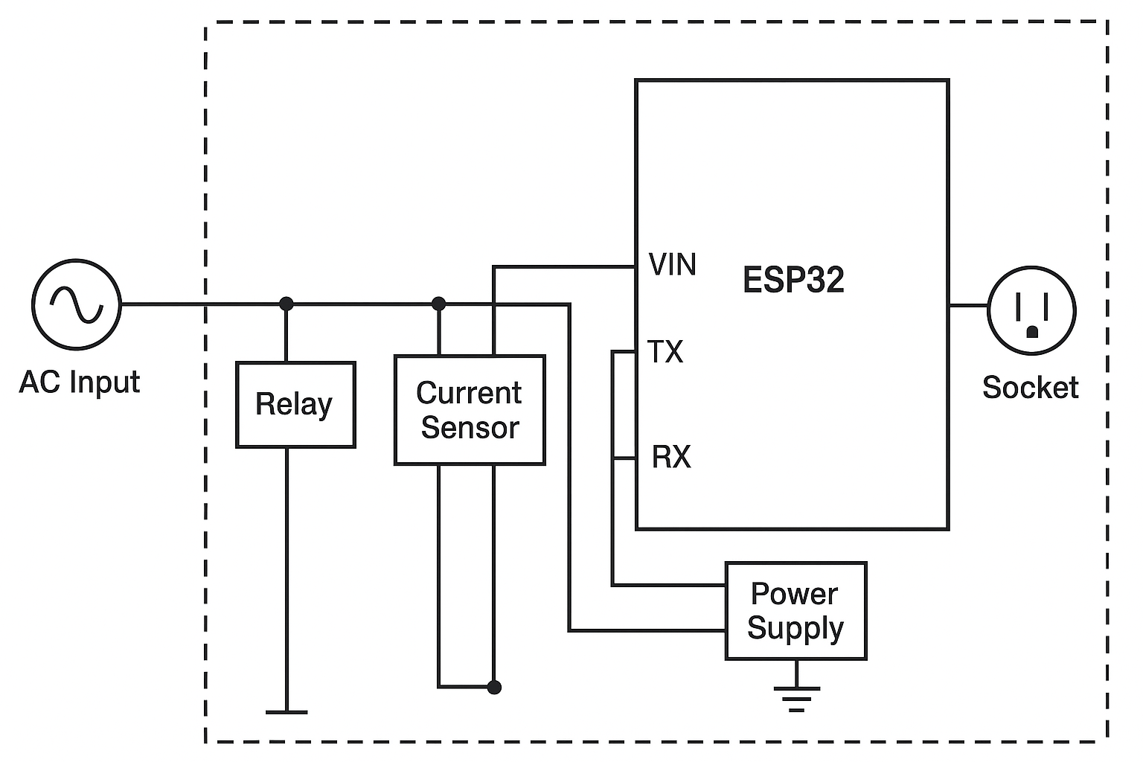

Slide 9
Future Work
Voice assistant integration
Multi-plug dashboard
AI-based energy suggestions
Dedicated mobile app

Slide 10
References
Espressif Systems. (2020). ESP32 series datasheet. Retrieved from https://www.espressif.com/en/products/socs/esp32
Allegro Microsystems. (2019). ACS712 current sensor IC datasheet. Retrieved from https://www.allegromicro.com/en/products/sense/current-sensor-ics/zero-to-fifty-amp-integrated-conductor-sensor-ics/acs712
Arduino. (n.d.). Arduino IDE documentation. Retrieved from https://docs.arduino.cc/software/ide-v1
Blynk IoT Platform. (n.d.). Blynk documentation. Retrieved from https://blynk.io
MathWorks. (n.d.). ThingSpeak IoT analytics platform. Retrieved from https://thingspeak.com
OpenEnergyMonitor. (n.d.). Energy monitoring basics. Retrieved from https://learn.openenergymonitor.org

